Slide 1

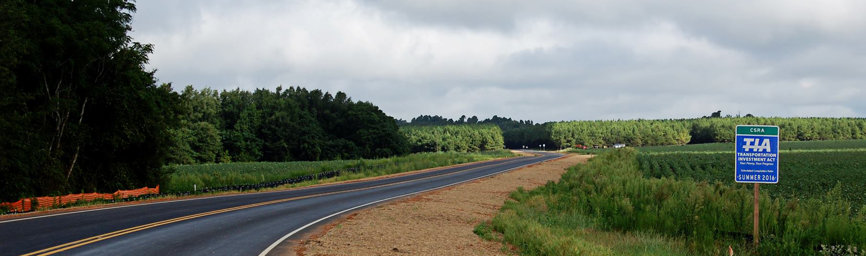

Transportation Investment Act
River Valley 1 CRP Update – August 13, 2024
Kenneth Franks, State TIA Administrator
William Eastin, TIA Regional Coordinator

Slide 2
TIA Regions
CSRA
River Valley
HOGA
Southern
Georgia

Slide 3
Final TIA 1 Collections Jan 2013 to Dec 2022
Region | Total | Approved Investment List (75%) | Local Discretionary (25%)
River Valley | $512,301,207 | $384,225,905 | $128,075,302
CSRA | $746,921,743 | $560,191,307 | $186,730,436
Heart of Georgia | $335,375,226 | $251,531,419 | $83,843,807
Southern Georgia* | $377,168,189 | $282,876,141 | $94,292,047
Totals | $1,971,766,365 | $1,478,824,772 | $492,941,592
*Ongoing Southern Georgia Collections Oct 2018 to May 2024

Slide 4
Final TIA 1 Collections Jan 2013 to Dec 2022
Region | Original Revenue Forecast | Actual Revenue Collected | % of Original Forecast
River Valley | $594,061,269 | $512,301,207 | -13.8%
CSRA | $841,044,916 | $746,921,743 | -11.2%
Heart of Georgia | $398,870,417 | $335,375,226 | -15.9%
Southern Georgia* | $283,905,450 | $377,168,189 | 32.9%
*Ongoing Southern Georgia Collections Oct 2018 to May 2024
Notes:
From Last Meeting (Dec 2023):
Region | Original Revenue Forecast | Actual Revenue Collected | % Behind Forecast
SG | $271,014,124 | $357,714,156 | 32.0%

Slide 5
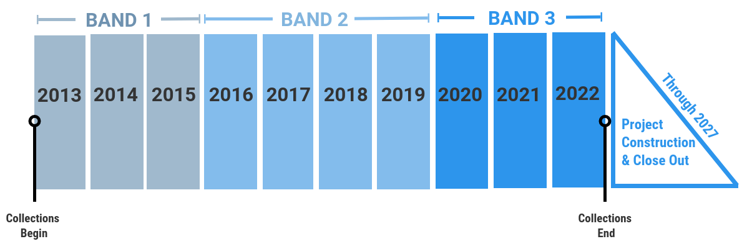
TIA 1 Timeline

Slide 6
River Valley Project Overview
23
Total Projects
$410,754,730
Final Investment List
Project Total
5
In Construction
17
Projects Completed
$276,439,695
Total Expenditure to Date
(as of May 2024)
Harris
Talbot
Taylor
Muscogee
Chattahoochee
Marion
Macon
Schley
Dooly
Stewart
Webster
Sumter
Crisp
Quitman
Randolph
Clay
Notes:
17 Projects Complete
5 in Construction
-Spiderweb
-US 280
-BV DDI
-Cusseta
-27 Widening
1 in Operations
- METRA

Slide 7
River Valley – TIA 1 Construction Updates
US 27 Widening &
Roundabout at SR 315 (Band 3)
Robinson Paving – 12/2022 letting
ROW acquisition ongoing - 3 remaining
Clearing and utility relocations ongoing
Storm drain installation and grading the roadway
Buena Vista Road DDI (Band 2)
CW Matthews – 9/2020 letting
Bridge, wall, and road work ongoing
  Bridge has been demo’d and traffic shifted to new section
Utility work finishing up
Landscaping will be completed by CW
Old Cusseta Rd @ I-185 Interchange
(Band 3)
Robinson Paving – 9/2022 letting
Utility relocations ongoing (W/S, gas, and telecom)
New Farr Rd sidewalks complete
Small additional ROW needed to be acquired to address inadequate slope behind retaining walls
US 280 Widening (Band 3)
Reeves Construction – 8/2020 letting
Open to traffic
Landscape and fence complete at Veterans Memorial Park
Contractor cleaning up
Notes:
6446
-177/180 parcels acquired (3 remaining – 92, 131, 148), 2 close to closing
- Post Office Coordination could take ~18 months
-Issued conditional NTP – Start date of 8/15/2023, Rev 4 issued 7/22/24
-16.5% complete
12577 – 68% complete – July 2024 completion date (AL will begin a time extension for the project due to utility delays)
11434 – 40% complete
422470 – 99% complete – July 2024 completion date

Slide 8
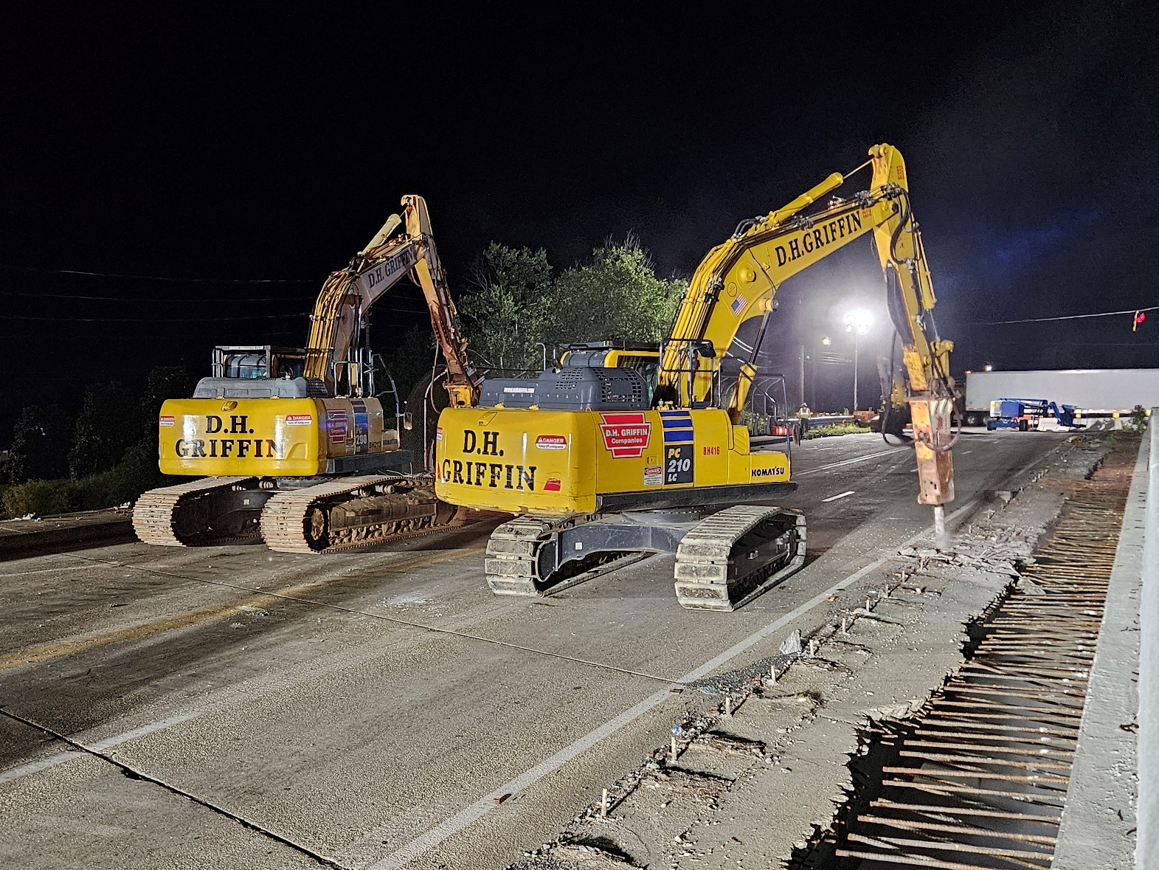
Buena Vista Road DDI
Bridge demo

Slide 9
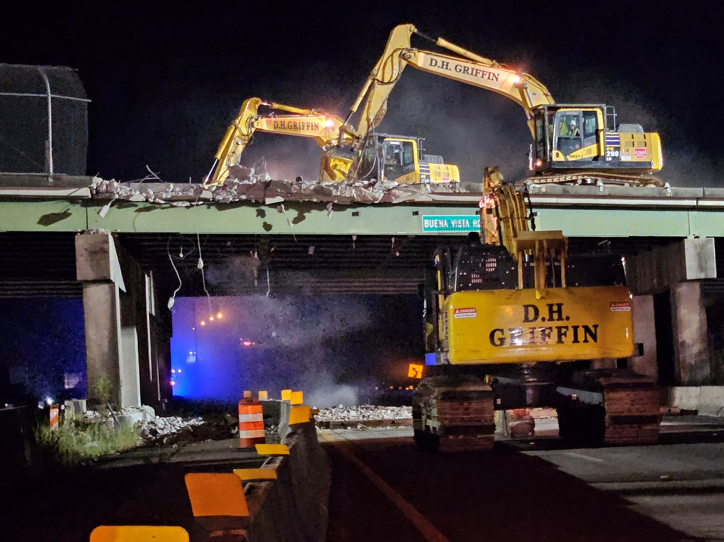
Buena Vista Road DDI
Bridge demo

Slide 10
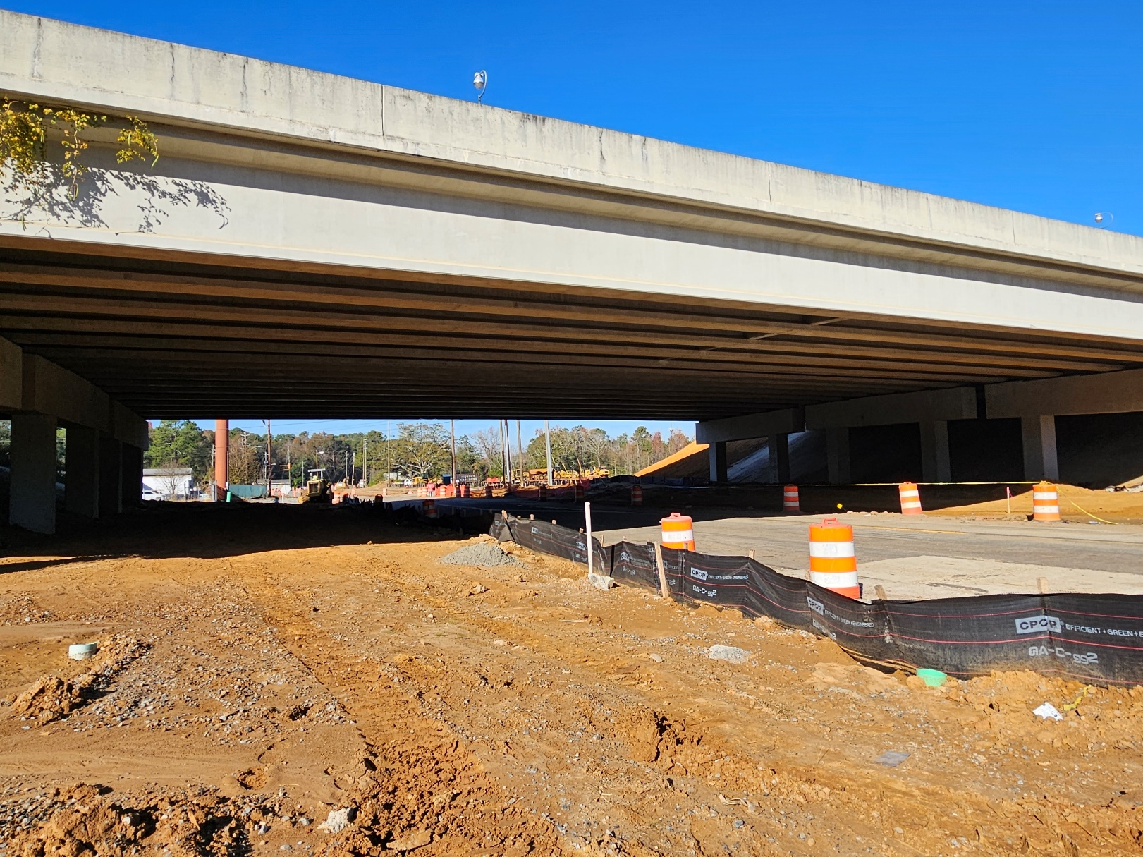
Old Cusseta Rd Interchange
Clearing under I-185 bridge on Old Cusseta Rd

Slide 11
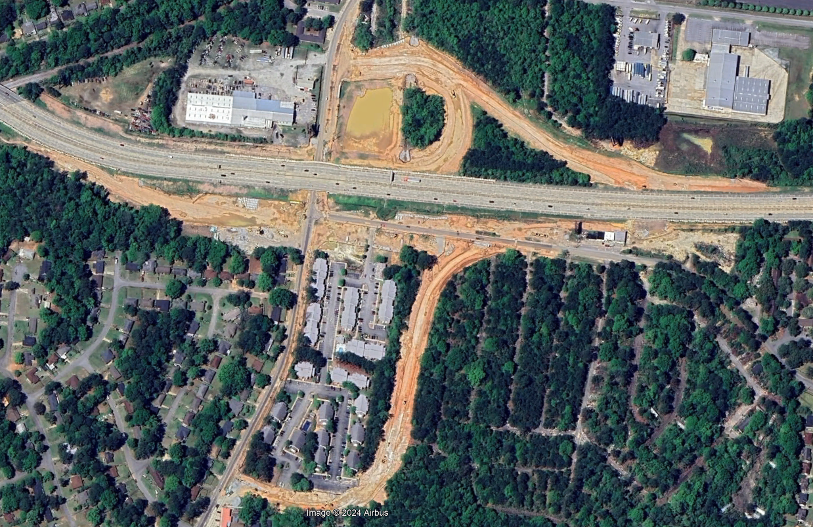
Old Cusseta Rd Interchange
Aerial from early April

Slide 12
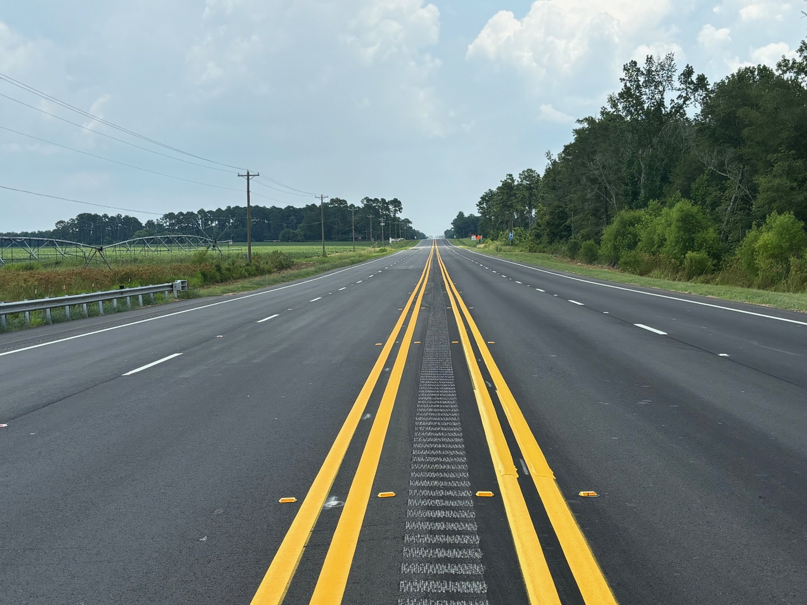
US 280 Widening
Open to Traffic

Slide 13
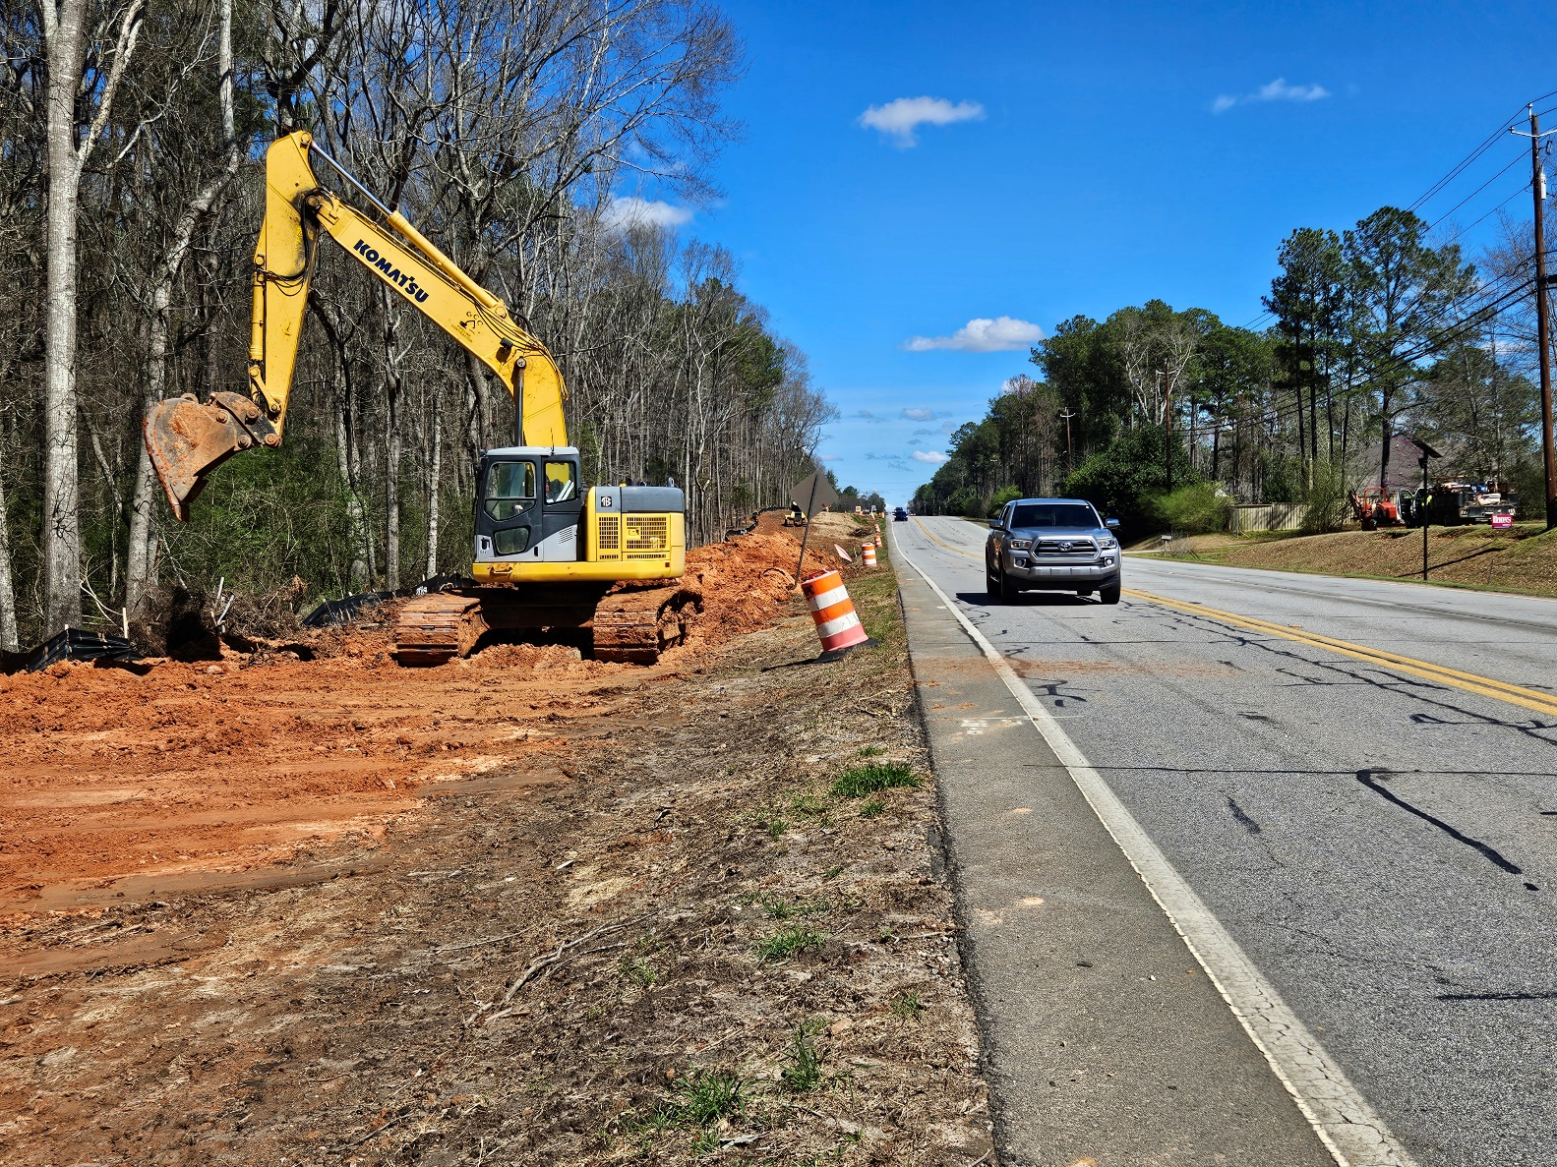
US 27 Widening
Clearing on west side of US 27, south of Coco Way/Secretariat Trl

Slide 14
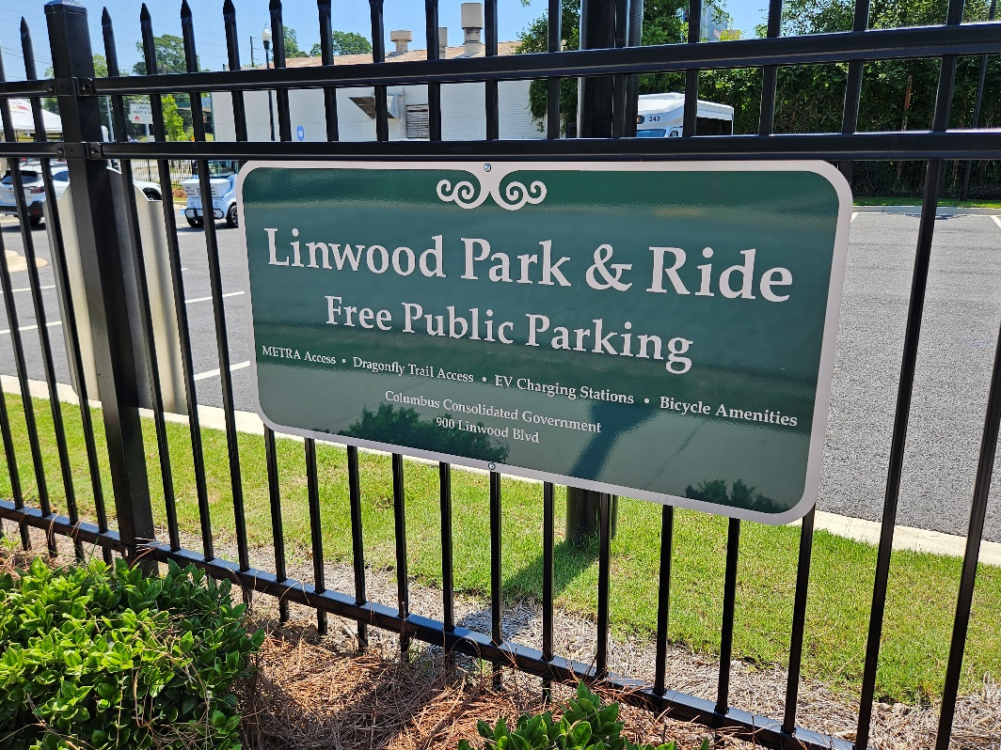
Columbus TIA Project Updates
Spider Web
Construction split into two phases
Phase 1 complete
Phase 2 bids over budget. CCG working with contractor on scope reduction and funding alternatives
METRA
Operations and maintenance ongoing
Park and Ride facility complete. Ribbon cutting was held on June 14.

Slide 15
Transportation Investment Act
River Valley 2 CRP Update – August 13, 2024
Kenneth Franks, State TIA Administrator
William Eastin, TIA Regional Coordinator

Slide 16
TIA Regions
CSRA
River Valley
HOGA
Southern
Georgia
Notes:
Southern GA approved TIA2 in May. 56.75% Yes vote

Slide 17
TIA 2 Collections Jan 2023 to May 2024
Region | Total | Approved Investment List (75%) | Local Discretionary (25%)
River Valley | $103,798,467 | $77,848,850 | $25,949,617
CSRA | $159,146,607 | $119,359,955 | $39,786,651
Heart of Georgia | $72,126,950 | $54,095,213 | $18,031,738
Totals | $353,073,024 | $251,304,018 | $83,768,006
Notes:
Dec 2023 Meeting
River Valley
$51,055,745 $38,291,606 $12,763,869
CSRA
$79,181,791 $59,386,343 $19,795,448
Heart of Georgia
$34,354,616 $25,765,962 $8,588,654
Totals
$164,591,882 $123,443,911 $41,147,970

Slide 18
TIA 2 Collections Jan 2023 to May 2024
Region | Original Revenue Forecast | Actual Revenue Collected | % of Original Forecast
River Valley | $88,221,993 | $103,798,467 | 17.6%
CSRA | $118,907,878 | $159,146,607 | 25.8%
Heart of Georgia | $53,754,896 | $72,126,950 | 34.2%

Slide 19
River Valley 2 Project Overview
45
Total Projects
$399,860,962
Final Investment List
Project Total
30
In Planning and Design
3
In Construction
1
Projects Completed
$380,664
Total Expenditure to Date
(as of May 2024)
Harris
Talbot
Taylor
Muscogee
Chattahoochee
Marion
Macon
Schley
Dooly
Stewart
Webster
Sumter
Crisp
Quitman
Randolph
Clay
Notes:
Complete:
Buck Creek - Macon
CST:
Chalybeate Springs – Talbot (3/24 let)
Lower Lumpkin – Quitman – (6/24 let)
Hospital Rd – Stewart – (5/24 let)

Slide 20
TIA 2 Timeline
BAND 1
BAND 2
BAND 3
2023
2024
2025
2026
2027
2028
2029
2030
2031
2032
Through 2037
Project Construction
& Close Out
Collections
Begin
August 2024
Collections
End

Slide 21
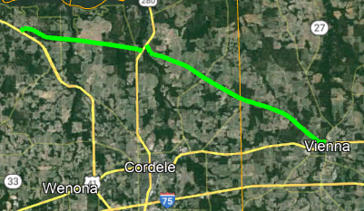
River Valley - TIA 2 (2023-2032)
Resurfacing Updates
Talbot County
Chalybeate Springs Rd (March 2024 Let)
  Robinson Paving
    $2.75M low bid – will begin in the Fall
Quitman County
Lower Lumpkin Rd (June 2024 Let)
  Negotiated with Oxford to bring bid down to budget
Clay and Randolph Counties
Cotton Hill Rd (December 2024 Let)
  19 mi from the SR 266 in Clay Co to SR 266 in Randolph Co
Dooly and Crisp Counties
Coney Rd (December 2026 Let)
  Four sections from Cotton St in Vienna to SR 300 in Crisp County
Coney Rd
Notes:
Budgets:
Chalybeate - $3M
Lower Lumpkin – $2.27M
Cotton Hill - $3.43M
Coney - $11.4M

Slide 22
River Valley - TIA 2 (2023-2032)
Preconstruction Updates
Batch 12 Procurements
Harris County
  SR 315 from Hart Dr to Hamilton, Mulberry Grove Rd Improvements
  SR 315 @ SR 219 Intersection Improvements
Muscogee County
  Buena Vista Road Improvements
  Manchester Expy/US 27 Alt @ County Line Rd Interchange Reconstruction
  Andrews Road Improvements
  Brennan Road Improvements
Batch 13 Procurements
Chattahoochee/Marion Counties
  SR 26 Passing Lanes
Randolph/Quitman Counties
  US 82 Passing Lanes
On-Call Procurements
Muscogee County
  US 80 Ramp Improvements
  University Ave Road Diet / Streetscape
Notes:
SR 315 – WSP: Held Kick off meeting with County and District, will collect traffic this month. Other project looking to add roundabouts at the ramps
Buena Vista – Stantec - Finalizing 1st TO
Manchester – Transystems – collected traffic, Traffic Report in progress; developing concept alternatives
Andrews/Brennan – Holt – Working on concept, held meeting with CCG, Working to reduce scope to get within budget. Hope to have PIOH by the end of the year
SR 26 – Gresham-Smith – Held kickoff meeting and will start concept work
US 82 – Transystems – Held kickoff meeting and will start concept work
US 80 – Potentially RBTs at each intersection. Collected traffic, working towards CR and env studies
University Ave – Holt – Held meeting with CCG, CSU. Will most likely keep 5 lane north of CSU drive. Reduce to 3 lane south to Macon Rd.

Slide 23
River Valley - TIA 2 (2023-2032)
Preconstruction Updates
Schley and Webster Counties
Churchill Rd and SR 153 Bridges (Band 1)
GDOT Bridge Office design
On-Call design for roadway
BFI (Bridge Foundation Investigation)
Muscogee County
Second Ave Improvements (Band 2)
Coordinating with GDOT maintenance project (M005022) to repave SR 85
Traffic to be collected this month
Marion County
Buena Vista Downtown Improvements –
Band 1
Stakeholder meeting on Aug 15th with city officials and local businesses
Harris County
Manchester Expy @ Central Church Rd -
Band 1
GDOT District Design
RCUT preferred, plan review in January 2025

Slide 24
River Valley - TIA 2 (2023-2032)
US 280 Preconstruction Updates
US 280 widening from Felder Street to District Line Rd - Band 2
Concept Report approved
Held PIOH on 11/16/23
Working on environmental doc (NELT)
US 280 widening from District Line Rd to SR 195 - Band 3
Working on concept
Environmental screening
US 280 widening from SR 195 to Lake Blackshear (Band 3)
Working on concept
Environmental screening
Notes:
0013579 - PIOH 11/16/2023 5pm to 7pm
0013579 – CPL
0013580 – Parsons
0013530 – H&L
NELT - Need, Effectiveness, and Logical Termini Form

Slide 25
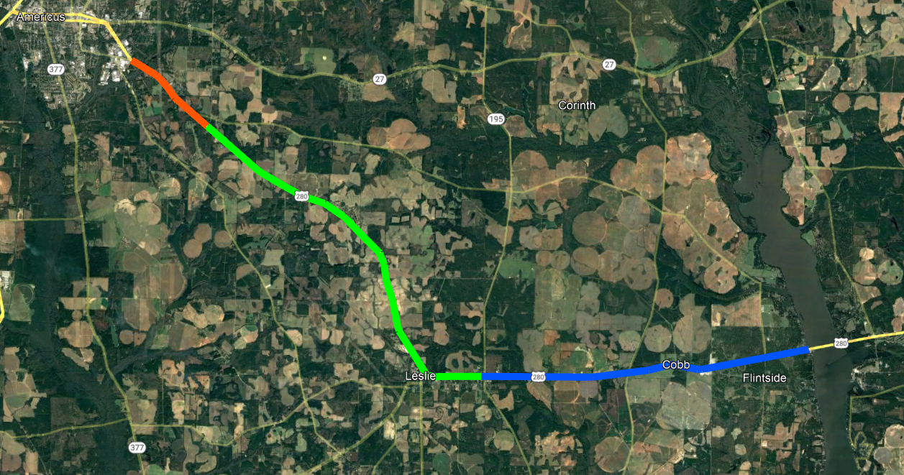
US 280 Corridor
Americus
PI# 0013579
Band 2
PI# 0013580
Band 3
Lake Blackshear
PI# 0013530
Band 3
Notes:
Non-TIA project to construct a roundabout at US 280 and Lamar Rd between Cobb and Lake Blackshear (PI# 0016112) – scheduled to Let Nov 2024

Slide 26
River Valley - TIA 2 (2023-2032)
Local Let Projects
Muscogee County
Steam Mill Road - Band 1
Revising concept report
Plan to pursue roundabout near the school first
Macon County
Buck Creek Bypass
Construction complete
Columbus Local Let Executed Agreements
Whitesville Road Widening
Columbus River Walk Repaving and Maintenance
South Lumpkin Rd Streetscape
13th Ave/17th St/Linwood Blvd Intersection Improvements
Liberty Theater Block Enhancement
5th Avenue Trail Connector
Taylor County
Ed Davis Rd/Rustin Lake Rd
Ed Davis resurfacing complete, Rustin Lake paving in design
Stewart County
Hospital Rd
  Oxford Construction
  $1,558,451 low bid
Notes:
CCG Notes:
Hospital Rd – Let May 2024; County requested approx. $136K change order to add some additional widening and replace paint w/ thermos for the striping and add RPMs to the road. No start date yet
Most just starting
5th Ave – CR approved 7/29

Slide 27
The TIA Office
Kenneth Franks
TIA Administrator
(404) 631-1568
kfranks@dot.ga.gov
Eric Wilkinson
Assistant TIA Administrator
(478) 538-8522
ewilkinson@dot.ga.gov
Jeramy Durrence
TIA Regional Coordinator
CSRA, HOGA, & SG
(404)694-6545
jdurrence@dot.ga.gov
Brent Moseley
TIA Regional Coordinator
SG & HOGA
(912) 661-7157
bmoseley@dot.ga.gov
William Eastin
TIA Regional Coordinator
River Valley & SG
(404) 904-4204
weastin@dot.ga.gov
www.ga-tia.com

