Slide 1

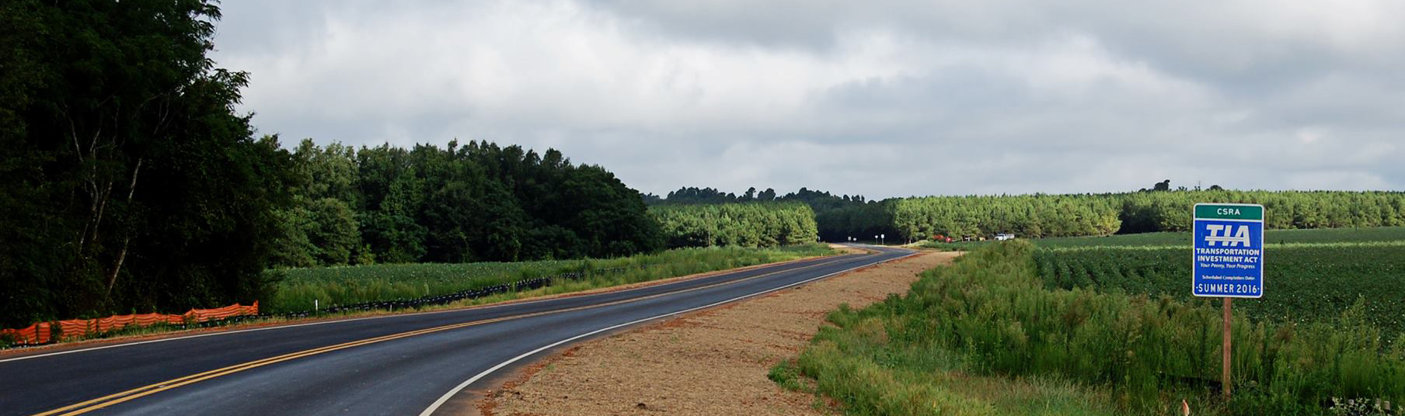

Transportation Investment Act
CSRA 1
November 15, 2023 CRP Update

Slide 2
TIA Regions
CSRA
River Valley
HOGA
Southern
Georgia
Notes:
Explain what is going on in the other regions.

Slide 3
TIA Collections thru December 2022
Region | Total | Approved Investment List (75%) | Local Discretionary (25%)
CSRA | $746,921,743* | $560,191,307* | $186,730,436*
River Valley | $512,301,207* | $384,225,905* | $128,075,302*
Heart of Georgia | $335,375,226* | $251,531,419* | $83,843,807*
Southern Georgia | $269,296,711* | $201,972,533* | $67,324,178*
Totals (*rounded amounts) | $1,863,894,887 | $1,397,921,164 | $465,973,722
Notes:
year over year growth 2021/2022(Strong Yr of collections)
Central Savannah River Area8.3%
River Valley5.8%
Heart of Georgia – Altamaha7.4%
Southern Georgia7.4%

Slide 4
TIA Collections thru December 2022
Region | Original Revenue Forecast | Actual Revenue Collected | % Behind Forecast
CSRA | $841,044,916* | $746,921,743* | -11.2%
River Valley | $594,061,269* | $512,301,207* | -13.8%
Heart of Georgia | $398,870,417* | $335,375,226* | -15.9%
Southern Georgia | $211,297,964* | $269,296,711* | 27.4%
Totals (*rounded amounts) | $2,045,274,565 | $1,863,894,887
Notes:
Looks Back slide…..January 2018
Central Savannah River Area -16.6%
River Valley -17.6%
Heart of Georgia – Altamaha -21.3%
TIA has always had to adapt and be ready to change
Band 1 37M under budget
Band 2 33M under budget

Slide 5
CSRA Project Overview
84
Total Projects
$546,514,666
Final Investment List
Project Total
26
In Construction
58
Projects Completed
$359,151,622
Total Expenditures
Wilkes
Lincoln
Taliaferro
Columbia
McDuffie
Warren
Hancock
Richmond
Glascock
Jefferson
Burke
Washington
Jenkins
Notes:
7 total projects left to award and let: 6 of these are currently in bidding and awaiting award. 1 operation project

Slide 6
Project Closeout
Projects in Construction | Projects Complete | Projects Financially Closed
26 | 17 | 41
Notes:
We are actively trying to close projects out financially. In the past year we have financially closed 16 projects.

Slide 7
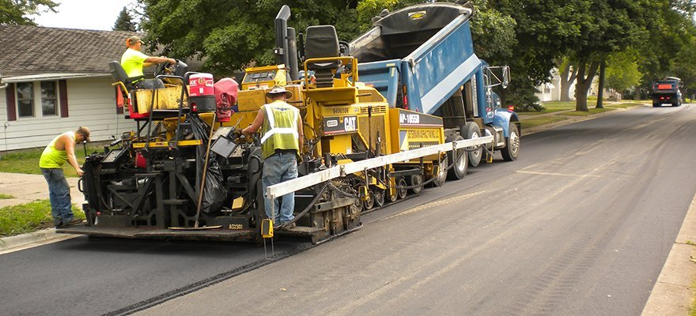
TIA Construction Updates

Slide 8

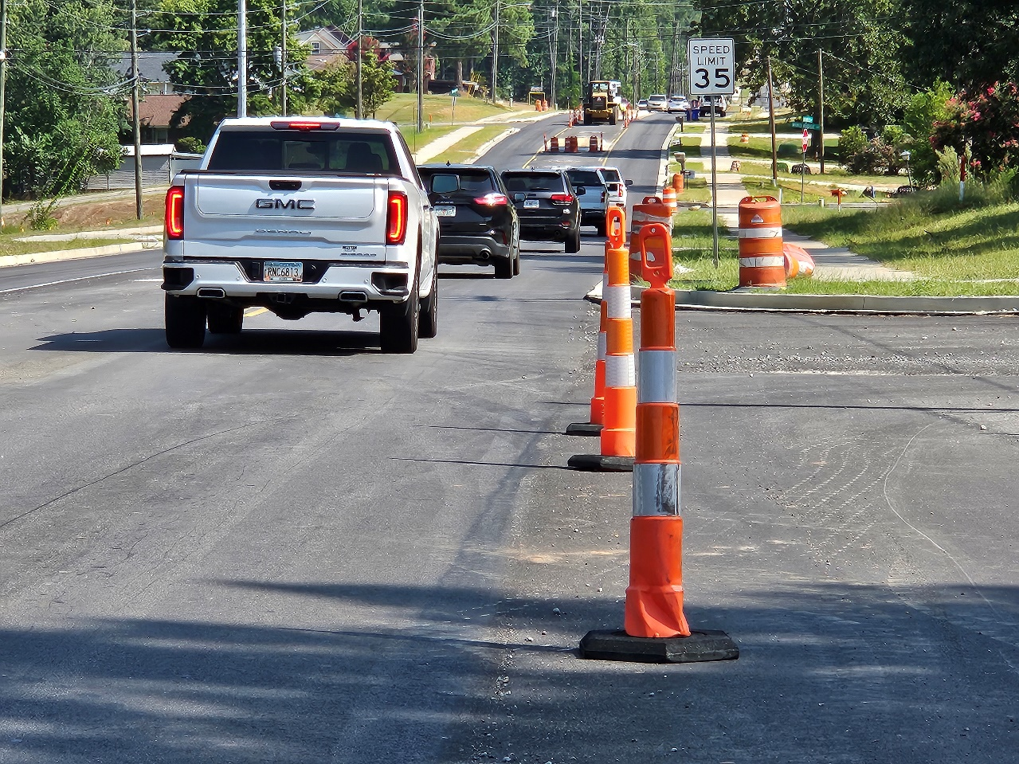
Flowing Wells Rd Widening
I-20 to SR 104/Washington Rd
Columbia County
Notes:
250600 - Flowing Wells Rd Widening
I-20 to SR 104/Washington Rd
TIA Investment: $20 million (PE,ROW,UTL,CST)
NTP: 12/2020
74% Complete

Slide 9
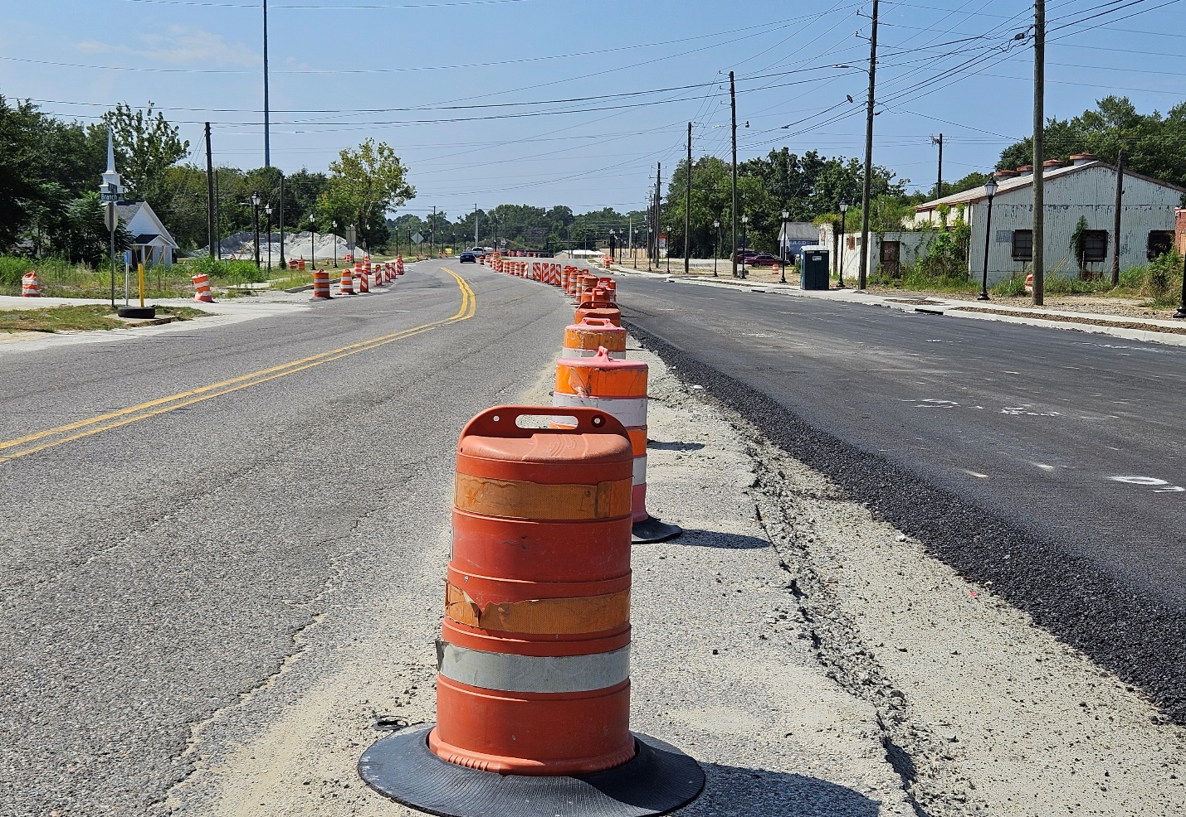
SR 4/15th Street Widening Richmond County
Notes:
220680 – Traffic shifted to new pavement on September 10, 2023
SR 4/15th Street Widening
TIA Investment $25 million (PE,ROW, CST)
NTP: 09/2019
75% Complete

Slide 10
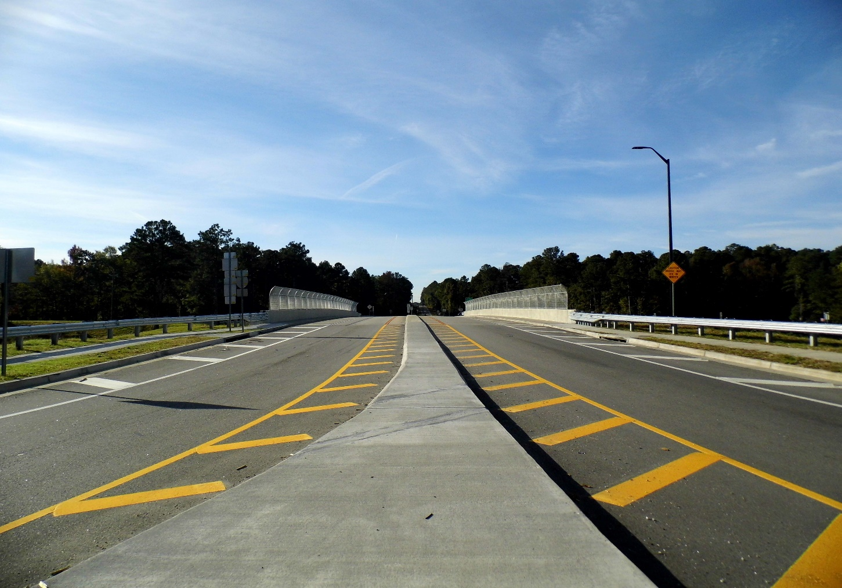
I-20/US 221/SR 47
Bridge/Interchange
Columbia County
Notes:
0011373 - I-20/US 221/SR 47
Bridge/Interchange
TIA Investment $7.4 million (PE,ROW, CST)
NTP: 04/2020
99% Complete

Slide 11
Columbia County Update

Slide 12
Richmond County Update

Slide 13
The TIA Office
Kenneth Franks
TIA Administrator
(404) 631-1568
kfranks@dot.ga.gov
Eric Wilkinson
Assistant TIA Administrator
(478)538-8522
ewilkinson@dot.ga.gov
Jeramy Durrence
TIA Regional Coordinator
CSRA
(404) 694-6545
jdurrence@dot.ga.gov
Brent Moseley
TIA Regional Coordinator
SG & HOGA
(912) 661-7157
bmoseley@dot.ga.gov
William Eastin
TIA Regional Coordinator
River Valley & SG
(404) 631-1810
weastin@dot.ga.gov
www.ga-tia.com

