Slide 1

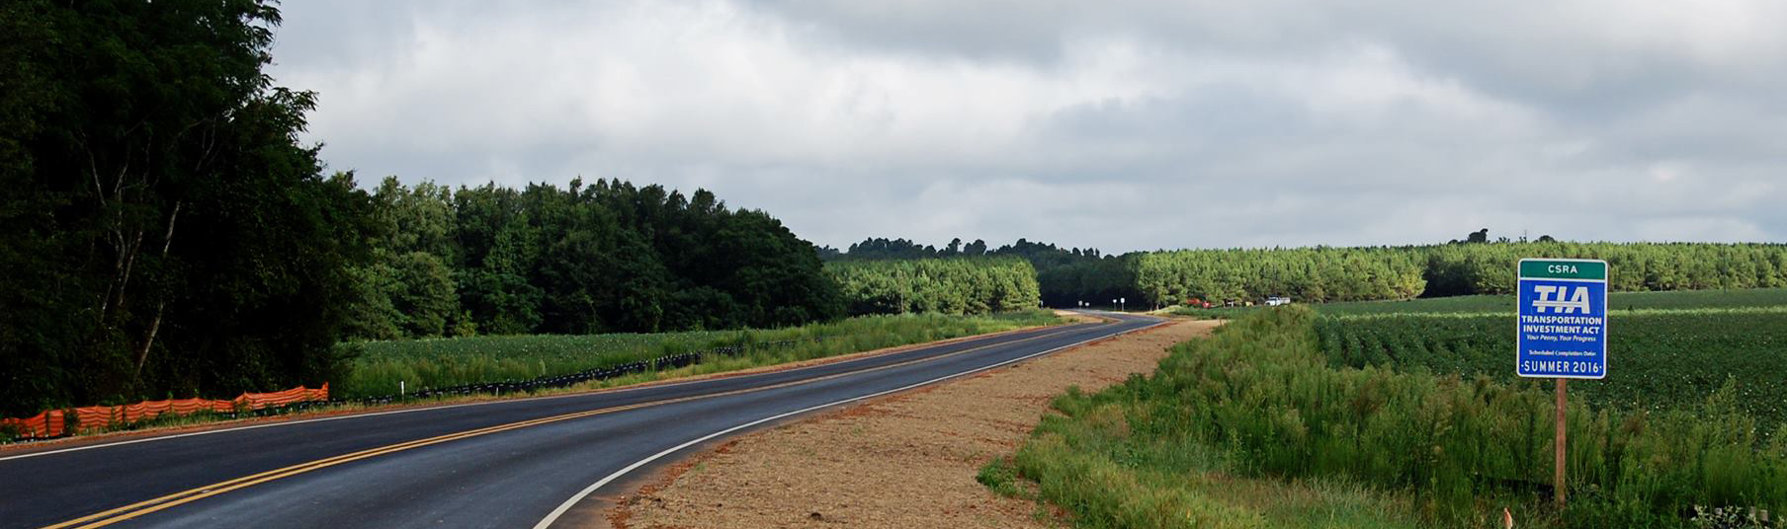

Transportation Investment Act
CSRA 2
November 15, 2023 CRP Update

Slide 2
TIA Regions
CSRA 2
River Valley 2
HOGA 2
Southern
Georgia

Slide 3
CSRA TIA 2 (2023-2032)
Wilkes
Lincoln
Taliaferro
McDuffie
Columbia
Warren
$ 923,161,980
10-year Forecast
162
Projects
Hancock
Richmond
Glascock
Jefferson
Burke
Washington
Jenkins
Notes:
Have started most of the projects that need design and

Slide 4
TIA Collections thru September 2023
Region | Total | Approved Investment List (75%) | Local Discretionary (25%)
CSRA | $79,181,790* | $59,386,342* | $19,795,448*
River Valley | $51,055,475* | $38,291,606* | $12,763,869*
Heart of Georgia | $34,354,616* | $25,765,962* | $8,588,654*
Southern Georgia | $325,451,119* | $244,088,339* | $81,362,780*
Totals (*rounded amounts) | $490,043,000 | $367,534,249 | $122,510,751

Slide 5
TIA Collections thru September 2023
Region | Original Revenue Forecast | Actual Revenue Collected | % of Forecast
CSRA | $62,645,179* | $79,181,791* | 26.4%
River Valley | $43,154,211* | $51,055,475* | 18.3%
Heart of Georgia | $25,334,247* | $34,354,616* | 35.6%
Southern Georgia | $249,541,613* | $325,451,119* | 30.4%
Totals (*rounded amounts) | $380,675,250 | $490,043,001 | 28.7%
Notes:
Much different position from TIA 1: Well ahead of forecast: Comparing the last three months to last year we have seen a 19% percent of year over year growth: From quarter to quarter growth is 8 %

Slide 6
CSRA Project Overview
162
Total Projects
$555,227,271
Final Investment List
Project Total
14
In Construction
1
Projects Completed
$7,671,078
Total Expenditures
Wilkes
Lincoln
Taliaferro
Columbia
McDuffie
Warren
Hancock
Richmond
Glascock
Jefferson
Burke
Washington
Jenkins
Notes:
William Few Pkwy in Columbia County is the 1 project complete:

Slide 7
TIA2 Project Updates
23 Projects awarded for PE
4 Projects under review for PE
Local Application process currently underway for 41 Projects
14 Projects currently under construction
1 Resurfacing project complete

Slide 8

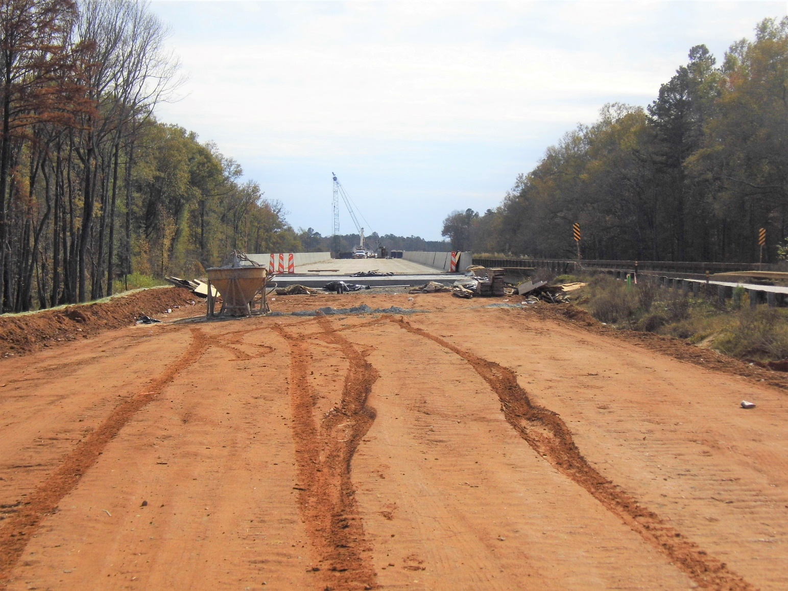
SR 4/US 1 Widening
Nimrod Rd To Louisville Bypass
Jefferson County
Notes:
222120 - SR 4/US 1 Widening FM N of Nimrod Rd To Louisville Bypass
$50M total with TIA $3M
NTP – 02/2022
35% Complete

Slide 9
Columbia County Update

Slide 10
Richmond County Update

Slide 11
The TIA Office
Kenneth Franks
TIA Administrator
(404) 631-1568
kfranks@dot.ga.gov
Eric Wilkinson
Assistant TIA Administrator
(478)538-8522
ewilkinson@dot.ga.gov
Jeramy Durrence
TIA Regional Coordinator
CSRA
(404) 694-6545
jdurrence@dot.ga.gov
Brent Moseley
TIA Regional Coordinator
SG & HOGA
(912) 661-7157
bmoseley@dot.ga.gov
William Eastin
TIA Regional Coordinator
River Valley & SG
(404) 631-1810
weastin@dot.ga.gov
www.ga-tia.com

