Slide 1

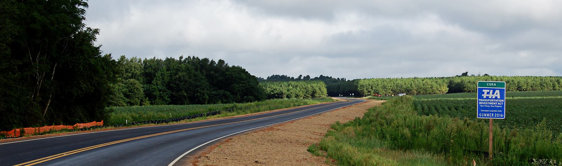

Transportation Investment Act
River Valley 1 CRP Update – December 4, 2024
Kenneth Franks, State TIA Administrator
William Eastin, TIA Regional Coordinator

Slide 2
TIA Regions
CSRA
River Valley
HOGA
Southern
Georgia

Slide 3
Final TIA 1 Collections Jan 2013 to Dec 2022
Region | Total | Approved Investment List (75%) | Local Discretionary (25%)
River Valley | $512,301,207 | $384,225,905 | $128,075,302
CSRA | $746,921,743 | $560,191,307 | $186,730,436
Heart of Georgia | $335,375,226 | $251,531,419 | $83,843,807
Southern Georgia* | $403,035,088 | $302,276,316 | $100,758,772
Totals | $1,971,766,365 | $1,478,824,772 | $492,941,592
*Ongoing Southern Georgia Collections Oct 2018 to Sept 2024

Slide 4
Final TIA 1 Collections Jan 2013 to Dec 2022
Region | Original Revenue Forecast | Actual Revenue Collected | % of Original Forecast
River Valley | $594,061,269 | $512,301,207 | -13.8%
CSRA | $841,044,916 | $746,921,743 | -11.2%
Heart of Georgia | $398,870,417 | $335,375,226 | -15.9%
Southern Georgia* | $301,452,054 | $403,035,088 | 33.7%
*Ongoing Southern Georgia Collections Oct 2018 to Sept 2024
Notes:
From Last Meeting (Dec 2023):
Region | Original Revenue Forecast | Actual Revenue Collected | % Behind Forecast
SG | $271,014,124 | $357,714,156 | 32.0%

Slide 5
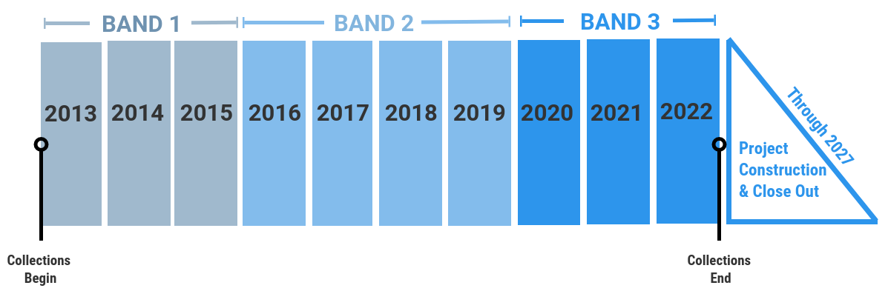
TIA 1 Timeline

Slide 6
River Valley Project Overview
23
Total Projects
$410,754,730
Final Investment List
Project Total
4
In Construction
18
Projects Completed
$304,458,351
Total Expenditure to Date
(as of Nov 21, 2024)
Harris
Talbot
Taylor
Muscogee
Chattahoochee
Marion
Macon
Schley
Dooly
Stewart
Webster
Sumter
Crisp
Quitman
Randolph
Clay
Notes:
17 Projects Complete
4 in Construction
-Spiderweb
-BV DDI
-Cusseta
-27 Widening
1 in Operations
- METRA

Slide 7
River Valley – TIA 1 Construction Updates
US 27 Widening &
Roundabout at SR 315 (Band 3)
Robinson Paving – 12/2022 letting
ROW acquisition ongoing - 1 remaining
Clearing, grading, and utility relocations ongoing
Grading for new 315 roundabout has begun
Buena Vista Road DDI (Band 2)
CW Matthews – 9/2020 letting
Bridge work has started on WB side
Ramp grading continues
Working on SA for landscaping
Old Cusseta Rd @ I-185 Interchange
(Band 3)
Robinson Paving – 9/2022 letting
Utility relocations ongoing (W/S, gas, and telecom)
New Farr Rd opening beginning of this month
Ramp grading and paving continues
US 280 Widening (Band 3)
Reeves Construction – 8/2020 letting
Complete and open to traffic
Notes:
6446
-180/181 parcels acquired (1 remaining – 131), offer has been sent
-22% complete
12577 – 70% complete – (AL will begin a time extension for the project due to utility delays)
11434 – 47% complete
422470 – complete

Slide 8
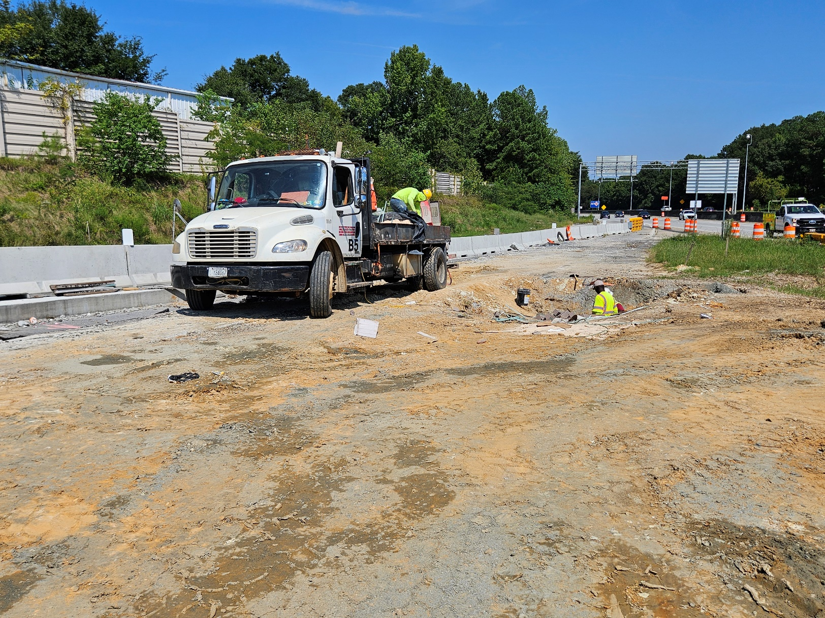
Buena Vista Road DDI

Slide 9
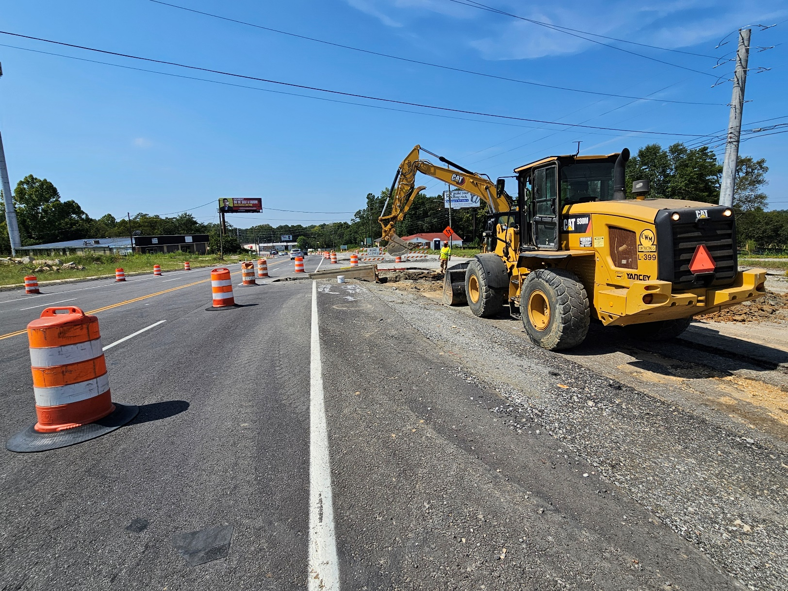
Buena Vista Road DDI

Slide 10
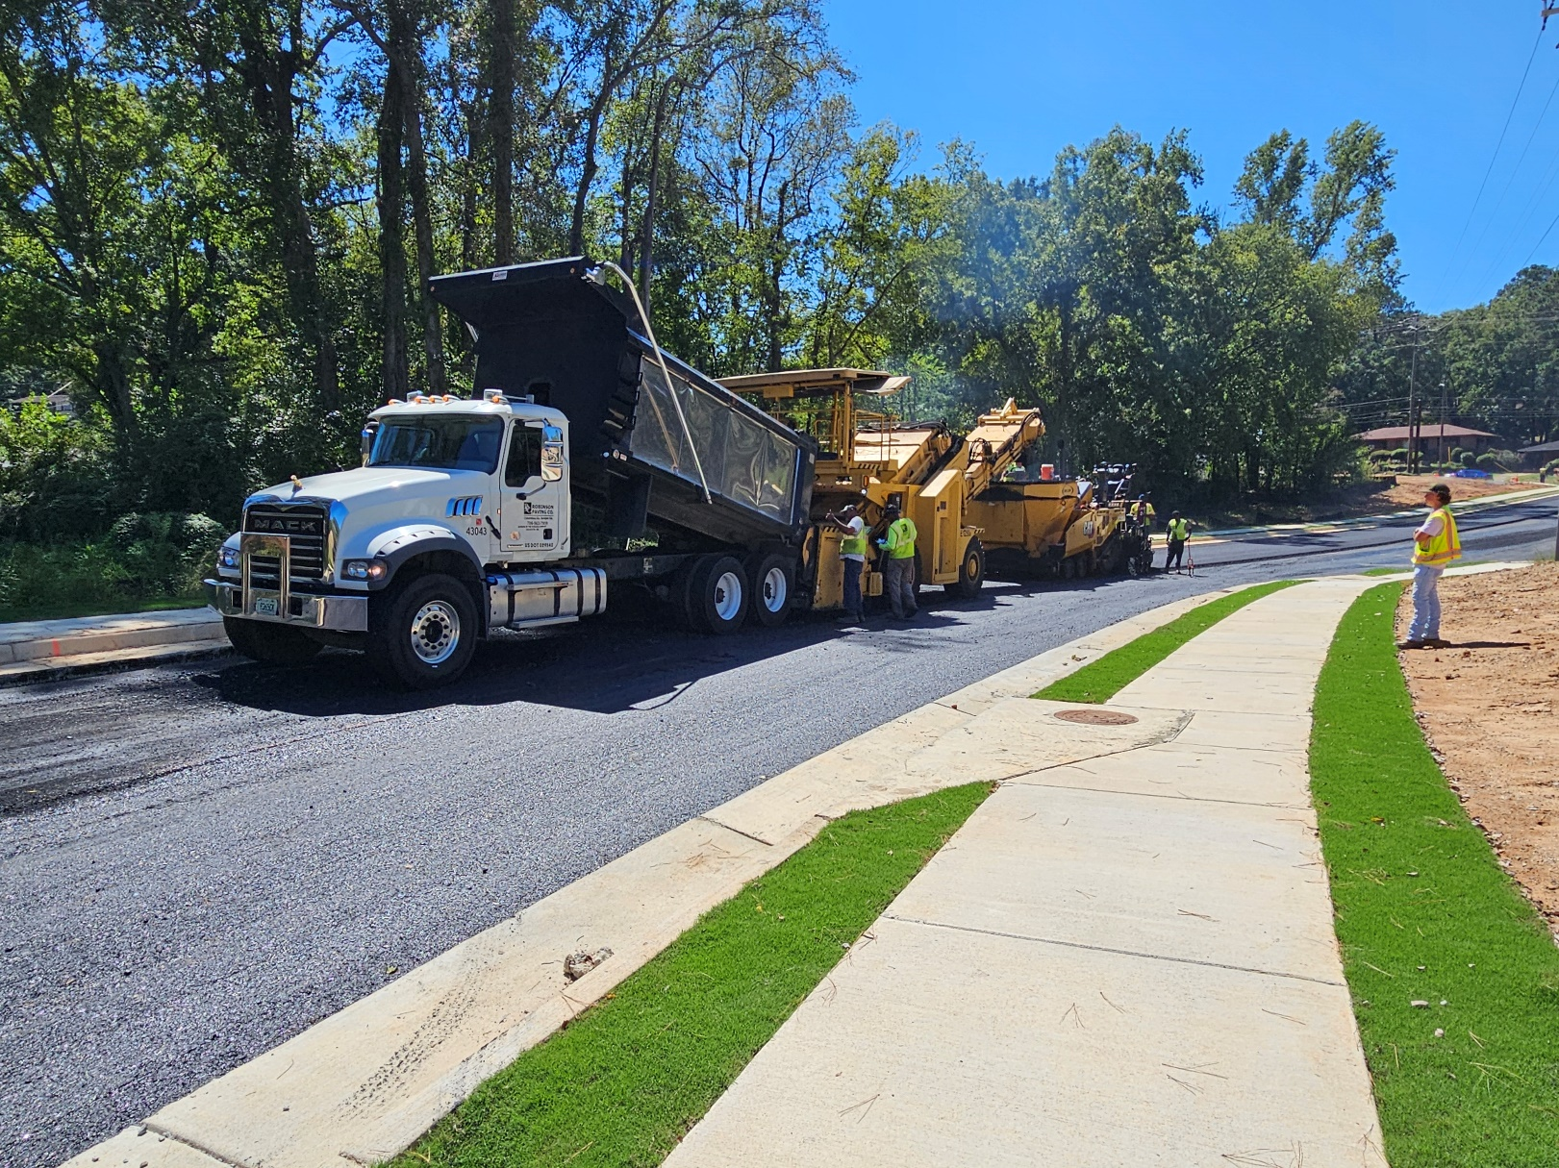
Old Cusseta Rd Interchange
Paving on New Farr Rd

Slide 11
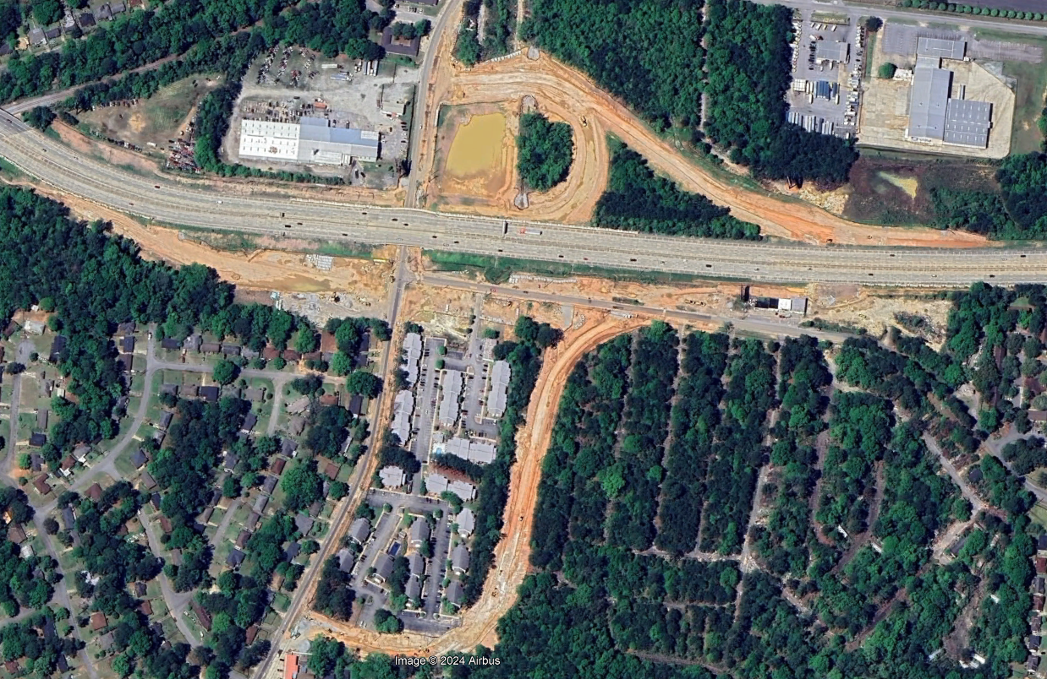
Old Cusseta Rd Interchange
Aerial from early April

Slide 12
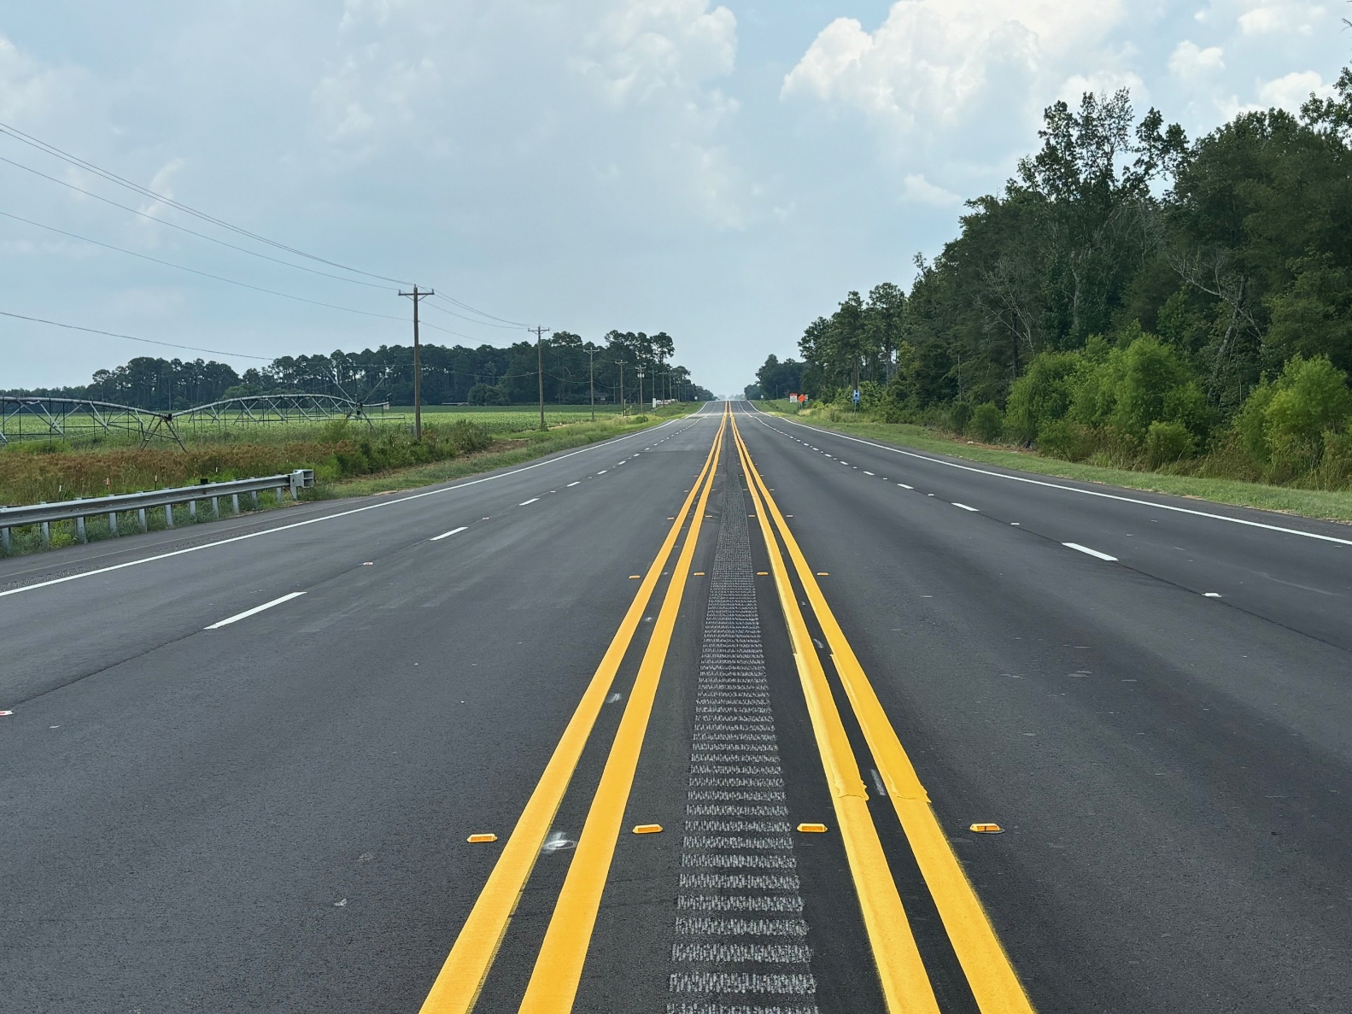
US 280 Widening
Complete

Slide 13
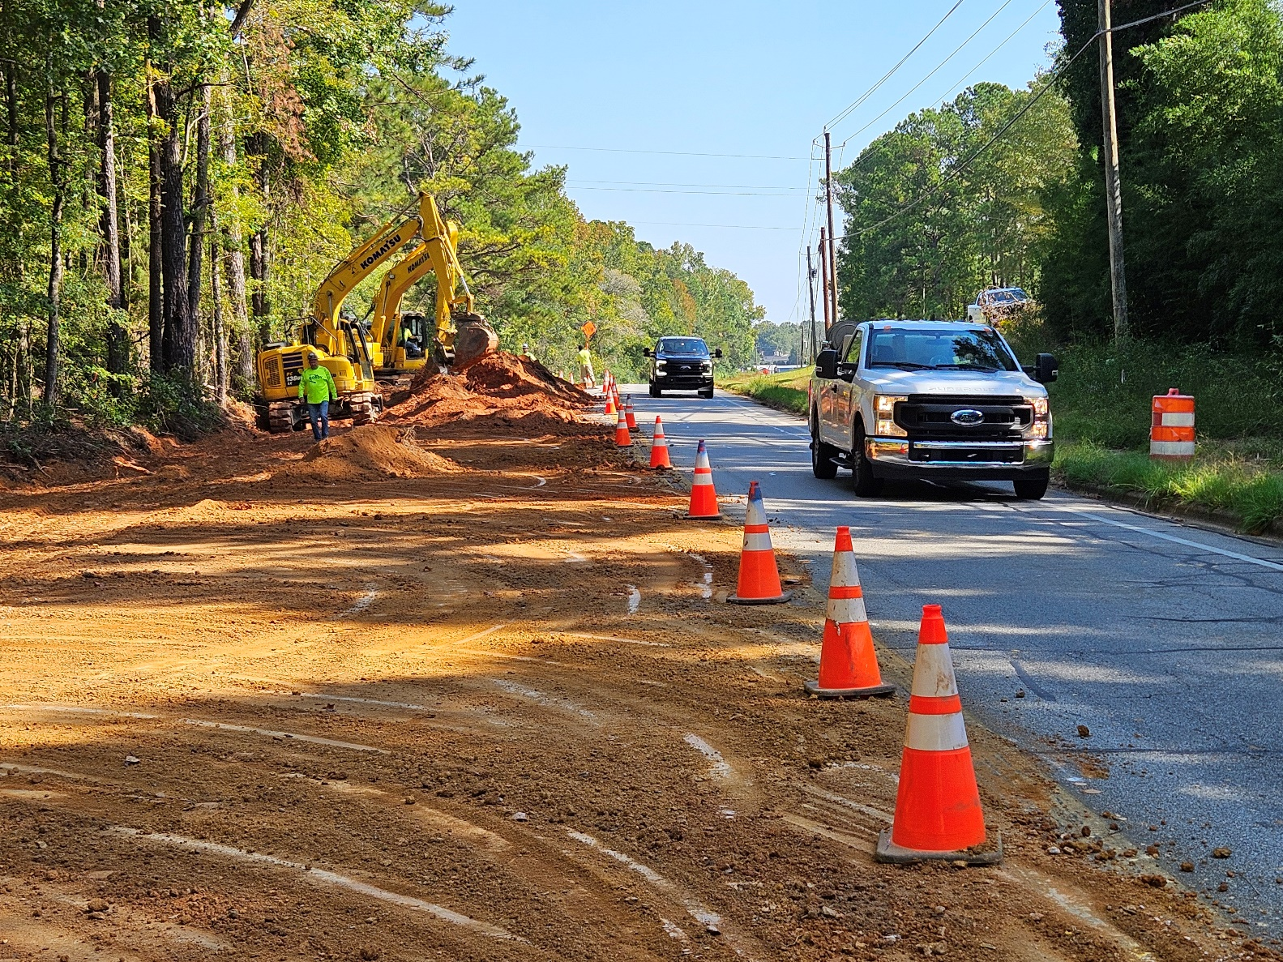
US 27 Widening
Clearing and grading

Slide 14
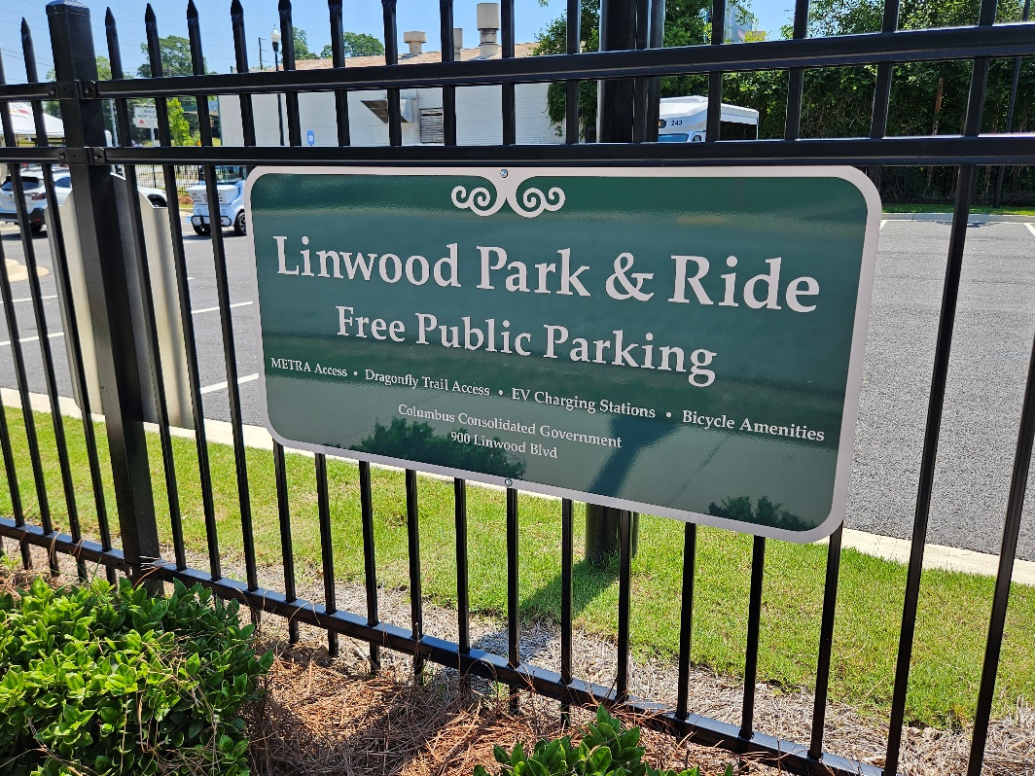
Columbus TIA Project Updates
Spider Web
Construction split into two phases
Phase 1 complete
Phase 2 bid approved by CCG Council
METRA
Operations and maintenance ongoing
Park and Ride facility complete.
New agreement executed

Slide 15
Transportation Investment Act
River Valley 2 CRP Update – December 4, 2024
Kenneth Franks, State TIA Administrator
William Eastin, TIA Regional Coordinator

Slide 16
TIA Regions
CSRA
River Valley
HOGA
Southern
Georgia
Notes:
Southern GA approved TIA2 in May. 56.75% Yes vote

Slide 17
TIA 2 Collections Jan 2023 to Oct 2024
Region | Total | Approved Investment List (75%) | Local Discretionary (25%)
River Valley | $127,156,174 | $95,367,130 | $31,789,043
CSRA | $194,637,534 | $145,978,150 | $48,659,383
Heart of Georgia | $83,868,666 | $63,874,233 | $19,994,433
Totals | $390,093,438 | $297,074,809 | $93,018,629
Notes:
Dec 2023 Meeting
River Valley
$51,055,745 $38,291,606 $12,763,869
CSRA
$79,181,791 $59,386,343 $19,795,448
Heart of Georgia
$34,354,616 $25,765,962 $8,588,654
Totals
$164,591,882 $123,443,911 $41,147,970

Slide 18
TIA 2 Collections Jan 2023 to Aug 2024
Region | Original Revenue Forecast | Actual Revenue Collected | % of Original Forecast
River Valley | $103,304,875 | $120,911,850 | 17.0%
CSRA | $147,058,744 | $185,312,922 | 26.0%
Heart of Georgia | $61,763,787 | $83,868,666 | 35.8%

Slide 19
River Valley 2 Project Overview
45
Total Projects
$399,860,962
Final Investment List
Project Total
30
In Planning and Design
3
In Construction
1
Projects Completed
$6,654,021
Total Expenditure to Date
(as of August 2024)
Harris
Talbot
Taylor
Muscogee
Chattahoochee
Marion
Macon
Schley
Dooly
Stewart
Webster
Sumter
Crisp
Quitman
Randolph
Clay
Notes:
Complete:
Buck Creek - Macon
CST:
Chalybeate Springs – Talbot (3/24 let)
Lower Lumpkin – Quitman – (6/24 let)
Hospital Rd – Stewart – (5/24 let)
Bidding:
Cotton Hill Rd – Clay/Randolph (12/24 let)

Slide 20
TIA 2 Timeline
BAND 1
BAND 2
BAND 3
2023
2024
2025
2026
2027
2028
2029
2030
2031
2032
Through 2037
Project Construction
& Close Out
Collections
Begin
December 2024
Collections
End

Slide 21
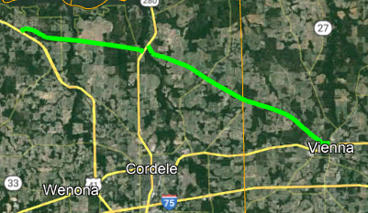
River Valley - TIA 2 (2023-2032)
Resurfacing Updates
Talbot County
Chalybeate Springs Rd (March 2024 Let)
  Robinson Paving
    90% - grass and shoulder work
Quitman County
Lower Lumpkin Rd (June 2024 Let)
  Oxford – Pre-Con held in Sept
Clay and Randolph Counties
Cotton Hill Rd (December 2024 Let)
  19 mi from the SR 266 in Clay Co to SR 266 in Randolph Co
  Advertised
Dooly and Crisp Counties
Coney Rd (December 2026 Let)
  Four sections from Cotton St in Vienna to SR 300 in Crisp County
Coney Rd
Notes:
Budgets:
Chalybeate - $3M
Lower Lumpkin – $2.27M 3/2025 Tentative start date
Cotton Hill - $3.43M
Coney - $11.4M

Slide 22
River Valley - TIA 2 (2023-2032)
Preconstruction Updates
Batch 12 Procurements
Harris County
  SR 315 from Hart Dr to Hamilton, Mulberry Grove Rd Improvements
  SR 315 @ SR 219 Intersection Improvements
Muscogee County
  Buena Vista Road Improvements
  Manchester Expy/US 27 Alt @ County Line Rd Interchange Reconstruction
  Andrews Road Improvements
  Brennan Road Improvements
Batch 13 Procurements
Chattahoochee/Marion Counties
  SR 26 Passing Lanes
Randolph/Quitman Counties
  US 82 Passing Lanes
On-Call Procurements
Muscogee County
  US 80 Ramp Improvements
  University Ave Road Diet / Streetscape
Notes:
SR 315 – WSP: -510: traffic approved, working on concept alternatives; -509: working on traffic report and concept alternatives
Buena Vista – Stantec – pre-concept work ongoing, traffic counts, ESB, and SUE package
Manchester – Transystems – concept layouts and env screening reports
Andrews/Brennan – Holt – concept report approved, coordinating PIOH
SR 26 – Gresham-Smith – Working on concept work
US 82 – Transystems – working on concept, will have virtual PIOH
US 80 – Potentially RBTs at each intersection. Working traffic report and CR
University Ave – Holt – Working on final design task order

Slide 23
River Valley - TIA 2 (2023-2032)
Preconstruction Updates
Schley and Webster Counties
Churchill Rd and SR 153 Bridges (Band 1)
GDOT Bridge Office design
On-Call design for roadway
Working on preliminary plans
Muscogee County
Second Ave Improvements (Band 2)
Coordinating with GDOT maintenance project (M005022) to repave SR 85
Working on traffic report and concept alternatives
Marion County
Buena Vista Downtown Improvements –
Band 1
Concept Report approved
Working on preliminary plans
Harris County
Manchester Expy @ Central Church Rd -
Band 1
GDOT District Design
RCUT preferred, held plan review last month and making updates
Notes:
Churchill Rd – Constructability review in Sept and PFPR in October
SR 153 – PFPR next week
DT BV – CR approved in August

Slide 24
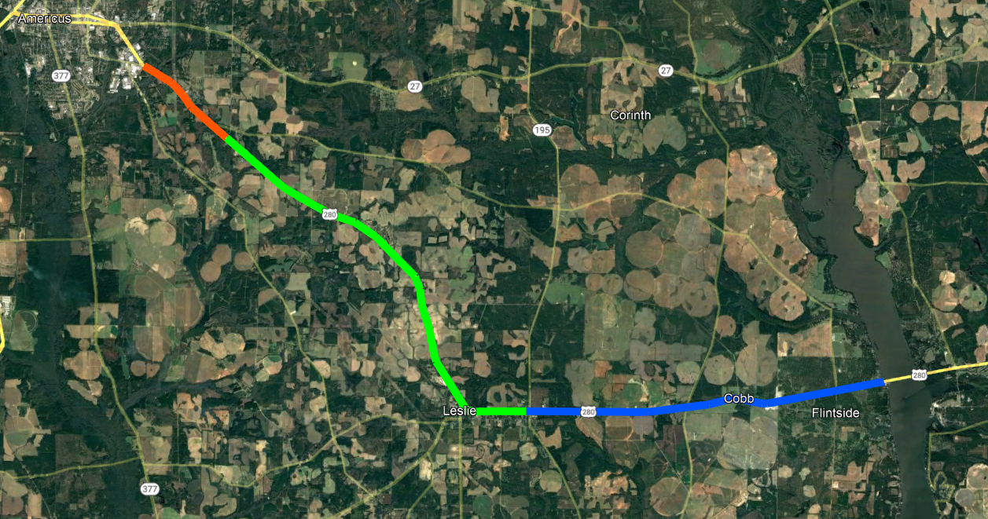
US 280 Corridor
Americus
PI# 0013579
Band 2
PI# 0013580
Band 3
Lake Blackshear
PI# 0013530
Band 3
Notes:
Non-TIA project to construct a roundabout at US 280 and Lamar Rd between Cobb and Lake Blackshear (PI# 0016112) – scheduled to Let Nov 2024

Slide 25
River Valley - TIA 2 (2023-2032)
US 280 Preconstruction Updates
US 280 widening from Felder Street to District Line Rd - Band 2
Working on environmental doc (NELT)
  Revising and submitting to FHWA
US 280 widening from District Line Rd to SR 195 - Band 3
Working on concept
Environmental screening
US 280 widening from SR 195 to Lake Blackshear (Band 3)
Working on concept
Environmental screening
Notes:
0013579 - PIOH 11/16/2023 5pm to 7pm
0013579 – CPL
0013580 – Parsons
0013530 – H&L
NELT - Need, Effectiveness, and Logical Termini Form

Slide 26
River Valley - TIA 2 (2023-2032)
Local Let Projects
Columbus Local Let Executed Agreements
Whitesville Road Widening
Columbus River Walk Repaving and Maintenance
South Lumpkin Rd Streetscape
13th Ave/17th St/Linwood Blvd Intersection Improvements
Liberty Theater Block Enhancement
5th Avenue Trail Connector
Morris Rd
Forrest Rd
Macon County
Buck Creek Bypass
Construction complete
Montezuma Airport
Working on bid package
Taylor County
Ed Davis Rd/Rustin Lake Rd
Ed Davis resurfacing complete, Rustin Lake paving in design
Finalizing bid package
Stewart County
Hospital Rd - Oxford Construction
  70% complete
Muscogee County
Steam Mill Road - Band 1
Revising concept report
Submitted ROW plans to TIA
Notes:
CCG Notes:
Hospital Rd – Let May 2024; County requested approx. $136K change order to add some additional widening and replace paint w/ thermos for the striping and add RPMs to the road. No start date yet
Most just starting
5th Ave – CR approved 7/29, presenting to CCG board
Airport – working runway design
METRA – Multi modal facility in design
13th/17th – ready for PIOH
Whitesville – finalizing CR
Morris – agreement executed
Forrest - agreement executed

Slide 27
The TIA Office
Kenneth Franks
TIA Administrator
(404) 631-1568
kfranks@dot.ga.gov
Eric Wilkinson
Assistant TIA Administrator
(478) 538-8522
ewilkinson@dot.ga.gov
Jeramy Durrence
TIA Regional Coordinator
CSRA, HOGA, & SG
(404)694-6545
jdurrence@dot.ga.gov
Brent Moseley
TIA Regional Coordinator
SG & HOGA
(912) 661-7157
bmoseley@dot.ga.gov
William Eastin
TIA Regional Coordinator
River Valley & SG
(404) 904-4204
weastin@dot.ga.gov
www.ga-tia.com

